Slide 1
Recovery Systems
Dr. M. Brindha
Assistant Professor
Department of CSE
NIT, Trichy-15

Slide 2
Failure Classification
Transaction failure :
Logical errors: transaction cannot complete due to some internal error condition
System errors: the database system must terminate an active transaction due to an error condition (e.g., deadlock)
System crash: a power failure or other hardware or software failure causes the system to crash.
Fail-stop assumption: non-volatile storage contents are assumed to not be corrupted by system crash
Database systems have numerous integrity checks to prevent corruption of disk data
Disk failure: a head crash or similar disk failure destroys all or part of disk storage
Destruction is assumed to be detectable: disk drives use checksums to detect failures

Slide 3
Recovery Algorithms
Recovery algorithms are techniques to ensure database consistency and transaction atomicity and durability despite failures
Recovery algorithms have two parts
Actions taken during normal transaction processing to ensure enough information exists to recover from failures
Actions taken after a failure to recover the database contents to a state that ensures atomicity, consistency and durability

Slide 4
Storage Structure
Volatile storage:
does not survive system crashes
examples: main memory, cache memory
Nonvolatile storage:
survives system crashes
examples: disk, tape, flash memory, non-volatile (battery backed up) RAM
Stable storage:
a mythical form of storage that survives all failures
approximated by maintaining multiple copies on distinct nonvolatile media

Slide 5
Stable-Storage Implementation
Maintain multiple copies of each block on separate disks
copies can be at remote sites to protect against disasters such as fire or flooding.
Failure during data transfer can still result in inconsistent copies: Block transfer can result in
Successful completion
Partial failure: destination block has incorrect information
Total failure: destination block was never updated
Protecting storage media from failure during data transfer (one solution):
Execute output operation as follows (assuming two copies of each block):
Write the information onto the first physical block.
When the first write successfully completes, write the same information onto the second physical block.
The output is completed only after the second write successfully completes.

Slide 6
Stable-Storage Implementation (Cont.)
Protecting storage media from failure during data transfer (cont.):
Copies of a block may differ due to failure during output operation. To recover from failure:
First find inconsistent blocks:
Expensive solution: Compare the two copies of every disk block.
Better solution:
Record in-progress disk writes on non-volatile storage (Non-volatile RAM or special area of disk).
Use this information during recovery to find blocks that may be inconsistent, and only compare copies of these.
Used in hardware RAID systems
If either copy of an inconsistent block is detected to have an error (bad checksum), overwrite it by the other copy. If both have no error, but are different, overwrite the second block by the first block.

Slide 7
Data Access
Physical blocks are those blocks residing on the disk.
Buffer blocks are the blocks residing temporarily in main memory.
Block movements between disk and main memory are initiated through the following two operations:
input(B) transfers the physical block B to main memory.
output(B) transfers the buffer block B to the disk, and replaces the appropriate physical block there.
Each transaction T_{i} has its private work-area in which local copies of all data items accessed and updated by it are kept.
T_{i}'s local copy of a data item X is called x_{i}.
We assume, for simplicity, that each data item fits in, and is stored inside, a single block.

Slide 8
Data Access (Cont.)
Transaction transfers data items between system buffer blocks and its private work-area using the following operations :
read(X) assigns the value of data item X to the local variable x_{i}.
write(X) assigns the value of local variable x_{i} to data item {X} in the buffer block.
both these commands may necessitate the issue of an input(B_{X}) instruction before the assignment, if the block B_{X} in which X resides is not already in memory.
Transactions
Perform read(X) while accessing X for the first time;
All subsequent accesses are to the local copy.
After last access, transaction executes write(X).
output(B_{X}) need not immediately follow write(X). System can perform the output operation when it deems fit.

Slide 9
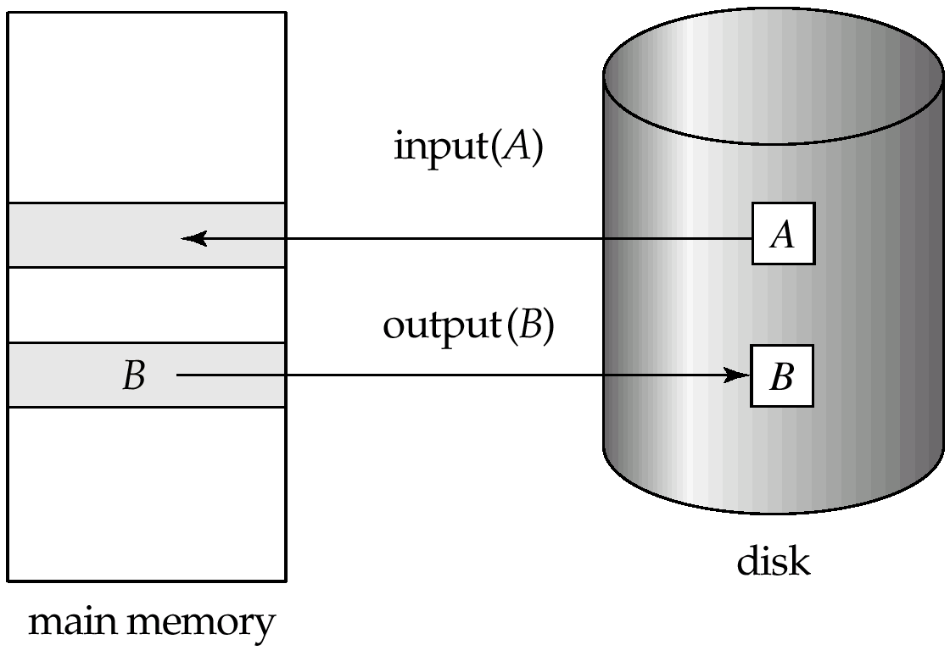
Block Storage Operations

Slide 10
Example of Data Access
buffer
Buffer Block A
input(A)
x
Buffer Block B
A
Y
output(B)
B
read(X)
write(Y)
x₂
disk
x₁
y₁
work area
of T₁
work area
of T₂
memory

Slide 11
Recovery and Atomicity
Modifying the database without ensuring that the transaction will commit may leave the database in an inconsistent state.
Consider transaction T_{i} that transfers $50 from account A to account B; goal is either to perform all database modifications made by T_{i} or none at all.
Several output operations may be required for T_{i} (to output A and B). A failure may occur after one of these modifications have been made but before all of them are made.

Slide 12
Recovery and Atomicity (Cont.)
To ensure atomicity despite failures, we first output information describing the modifications to stable storage without modifying the database itself.
We study two approaches:
log-based recovery, and
shadow-paging
We assume (initially) that transactions run serially, that is, one after the other.

Slide 13
Log-Based Recovery
A log is kept on stable storage.
The log is a sequence of log records, and maintains a record of update activities on the database.
When transaction T_{i} starts, it registers itself by writing a <T_{i} start>log record
Before T_{i} executes write(X), a log record <T_{i}, X, V₁, V₂> is written, where V₁ is the value of X before the write, and V₂ is the value to be written to X.
Log record notes that T_{i} has performed a write on data item X_{j} X_{j} had value V₁ before the write, and will have value V₂ after the write.
When T_{i} finishes it last statement, the log record <T_{i} commit> is written.
We assume for now that log records are written directly to stable storage (that is, they are not buffered)

Slide 14
Log-Based Recovery
Two approaches using logs
Deferred database modification
Immediate database modification

Slide 15
Deferred Database Modification
The deferred database modification scheme records all modifications to the log, but defers all the writes to after partial commit.
Assume that transactions execute serially
Transaction starts by writing <T_{i} start> record to log.
A write(X) operation results in a log record <T_{i}, X, V> being written, where V is the new value for X
Note: old value is not needed for this scheme
The write is not performed on X at this time, but is deferred.
When T_{i} partially commits, <T_{i} commit> is written to the log
Finally, the log records are read and used to actually execute the previously deferred writes.

Slide 16
Deferred Database Modification (Cont.)
During recovery after a crash, a transaction needs to be redone if and only if both <T_{i} start> and<T_{i} commit> are there in the log.
Redoing a transaction T_{i} ( redoT_{i}) sets the value of all data items updated by the transaction to the new values.
Crashes can occur while
the transaction is executing the original updates, or
while recovery action is being taken
example transactions T₀ and T₁ (T₀ executes before T₁):
T₀: read (A) T₁ : read (C)
A: - A - 50 C:-C- 100
Write (A) write (C)
read (B)
B:- B + 50
write (B)

Slide 17
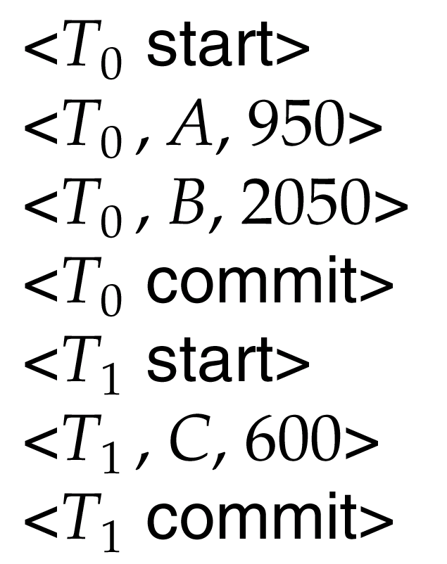
Portion of the Database Log Corresponding to T₀ and T₁

Slide 18
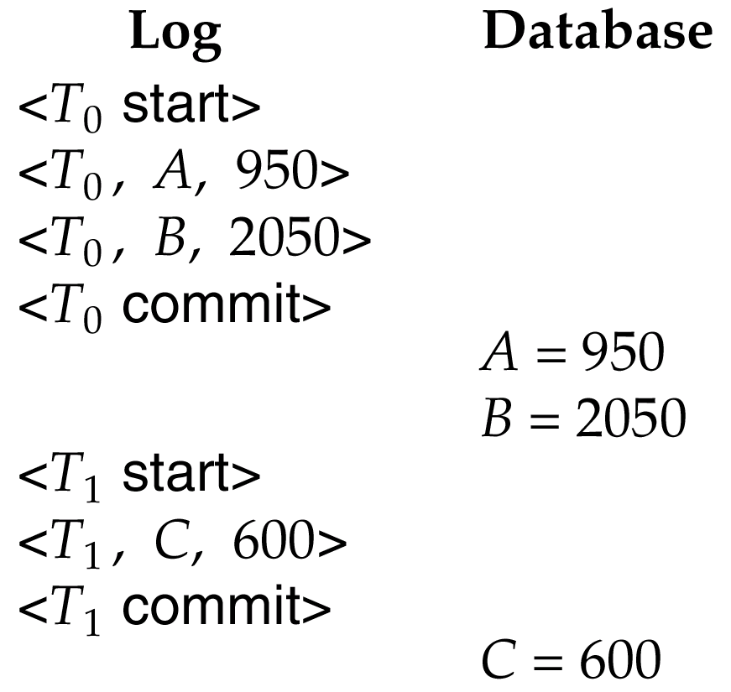
State of the Log and Database Corresponding to T₀ and T₁

Slide 19
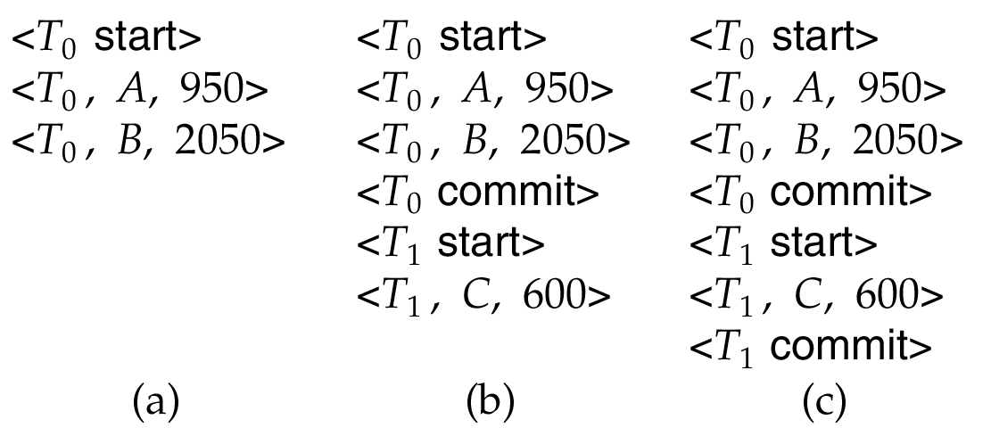
Deferred Database Modification (Cont.)
Below we show the log as it appears at three instances of time.
If log on stable storage at time of crash is as in case:
(a) No redo actions need to be taken
(b) redo(T₀) must be performed since <T₀ commit> is present
(c) redo(T₀) must be performed followed by redo(T₁) since
<T₀ commit> and <T_{i} commit> are present

Slide 20
Immediate Database Modification
The immediate database modification scheme allows database updates of an uncommitted transaction to be made as the writes are issued
since undoing may be needed, update logs must have both old value and new value
Update log record must be written before database item is written
We assume that the log record is output directly to stable storage
Can be extended to postpone log record output, so long as prior to execution of an output(B) operation for a data block B, all log records corresponding to items B must be flushed to stable storage
Output of updated blocks can take place at any time before or after transaction commit
Order in which blocks are output can be different from the order in which they are written.

Slide 21
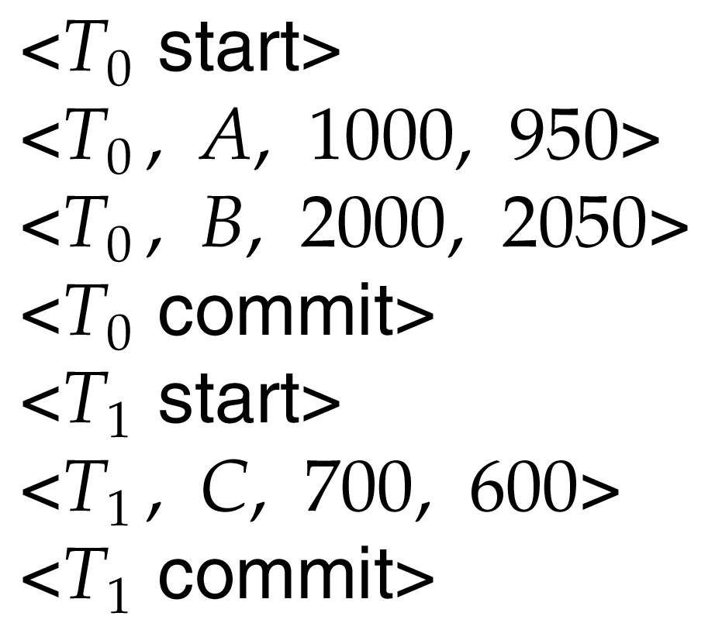
Portion of the System Log Corresponding to T₀ and T₁

Slide 22
Immediate Database Modification Example
Log Write Output
<T₀ start>
<T₀, A, 1000, 950>
T_{o}, B, 2000, 2050
A = 950
B = 2050
<T₀ commit>
<T₁ start>
<T₁, C, 700, 600>
C = 600
B_{B}, B_{C}
<T₁ commit>
B_{A}
Note: B_{X} denotes block containing X.
x₁

Slide 23
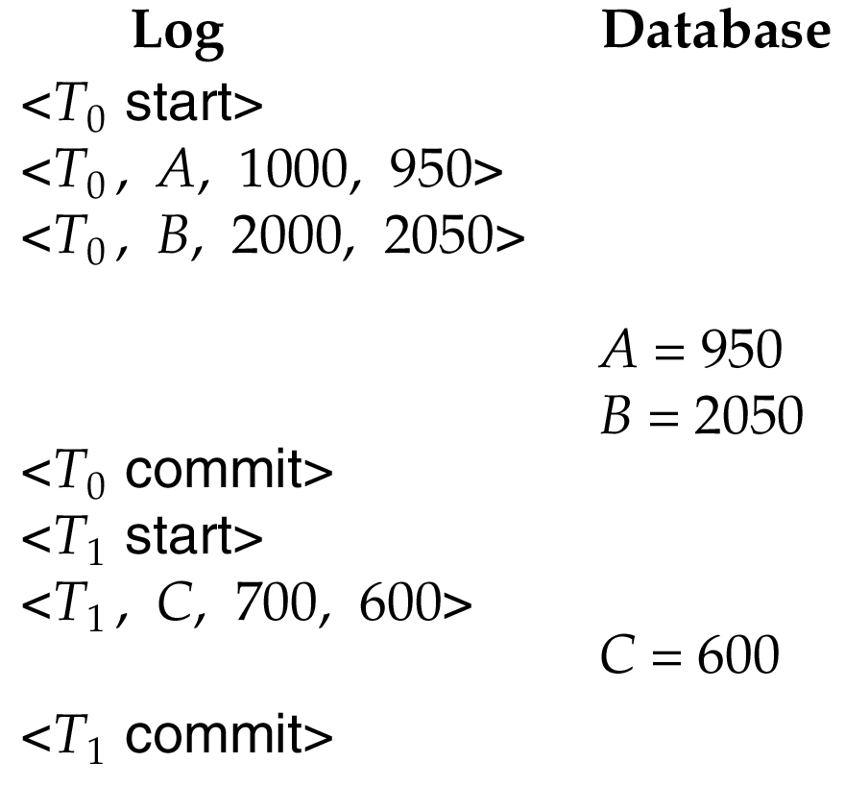
State of System Log and Database Corresponding to T₀ and T₁

Slide 24
Immediate Database Modification (Cont.)
Recovery procedure has two operations instead of one:
undo(T_{i}) restores the value of all data items updated by T_{i} to their old values, going backwards from the last log record for T_{i}
redo(T_{i}) sets the value of all data items updated by T_{i} to the new values, going forward from the first log record for T_{i}
Both operations must be idempotent
That is, even if the operation is executed multiple times the effect is the same as if it is executed once
Needed since operations may get re-executed during recovery
When recovering after failure:
Transaction T_{i} needs to be undone if the log contains the record <T_{i} start>, but does not contain the record <T_{i} commit>.
Transaction T_{i} needs to be redone if the log contains both the record <T_{i} start> and the record <T_{i} commit>.
Undo operations are performed first, then redo operations.

Slide 25
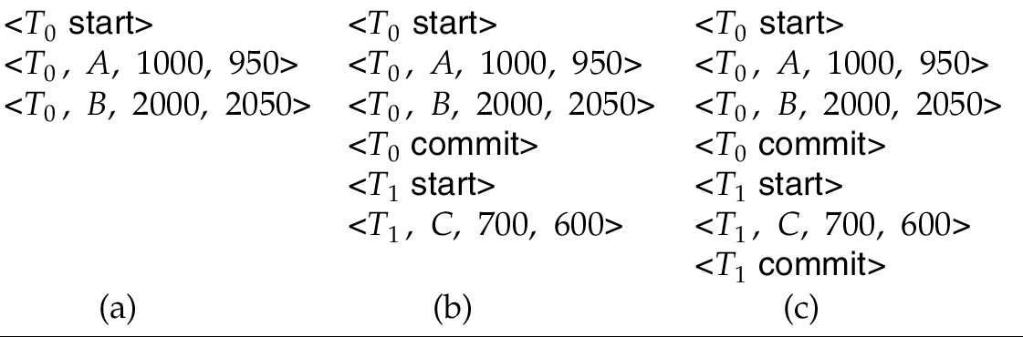
Immediate DB Modification Recovery Example
Below we show the log as it appears at three instances of time.
Recovery actions in each case above are:
(a) undo (T₀): B is restored to 2000 and A to 1000.
(b) undo (T₁) and redo (T₀): C is restored to 700, and then A and B are set to 950 and 2050 respectively.
(c) redo (T₀) and redo (T₁): A and B are set to 950 and 2050
respectively. Then C is set to 600

Slide 26
Checkpoints
Problems in recovery procedure as discussed earlier :
searching the entire log is time-consuming
we might unnecessarily redo transactions which have already output their updates to the database.
Streamline recovery procedure by periodically performing checkpointing
Output all log records currently residing in main memory onto stable storage.
Output all modified buffer blocks to the disk.
Write a log record < checkpoint> onto stable storage.

Slide 27
Checkpoints (Cont.)
During recovery we need to consider only the most recent transaction T_{i} that started before the checkpoint, and transactions that started after T_{i}.
Scan backwards from end of log to find the most recent <checkpoint> record
Continue scanning backwards till a record <T_{i} start> is found.
Need only consider the part of log following above start record. Earlier part of log can be ignored during recovery, and can be erased whenever desired.
For all transactions (starting from T_{i} or later) with no <T_{i} commit>, execute undo(T_{i}). (Done only in case of immediate modification.)
Scanning forward in the log, for all transactions starting from T_{i} or later with a <T_{i} commit>, execute redo(T_{i}).

Slide 28
Example of Checkpoints
T_{c}
T_{f}
T₁ can be ignored (updates already output to disk due to checkpoint)
T₂ and T₃ redone.
T₄ undone
T₁
T₂
T₃
T₄
checkpoint
system failure

Slide 29
Recovery With Concurrent Transactions
We modify the log-based recovery schemes to allow multiple transactions to execute concurrently.
All transactions share a single disk buffer and a single log
A buffer block can have data items updated by one or more transactions
We assume concurrency control using strict two-phase locking;
i.e. the updates of uncommitted transactions should not be visible to other transactions
Otherwise how to perform undo if T1 updates A, then T2 updates A and commits, and finally T1 has to abort?
Logging is done as described earlier.
Log records of different transactions may be interspersed in the log.
The checkpointing technique and actions taken on recovery have to be changed
since several transactions may be active when a checkpoint is performed.

Slide 30
Recovery Algorithm
Logging (during normal operation):
<T_{i} start> at transaction start
<T_{i}, X_{j}, V₁, V₂> for each update, and
<T_{i} commit> at transaction end
Transaction rollback (during normal operation)
Let T_{i} be the transaction to be rolled back
Scan log backwards from the end, and for each log record of T_{i} of the form <T_{i}, X_{j}, V₁, V₂>
perform the undo by writing V₁ to X_{j},
write a log record <T_{i} , X_{j}, V₁>
such log records are called compensation log records
Once the record <T_{i} start> is found stop the scan and write the log record <T_{i} abort>

Slide 31
Recovery Algorithm (Cont.)
Recovery from failure: Two phases
Redo phase: replay updates of all transactions, whether they committed, aborted, or are incomplete
Undo phase: undo all incomplete transactions
Redo phase:
Find last <checkpoint L> record, and set undo-list to L.
Scan forward from above <checkpoint L> record
Whenever a record <T_{i}, X_{j}, V₁, V₂> or <T_{i}, X_{j}, V₂> is found, redo it by writing V₂ to X_{j}
Whenever a log record <T_{i} start> is found, add T_{i} to undo-list
Whenever a log record <T_{i} commit> or <T_{i} abort> is found, remove T_{i} from undo-list

Slide 32
Recovery Algorithm (Cont.)
Undo phase:
Scan log backwards from end
Whenever a log record <T_{i}, X_{j}, V₁, V₂> is found where T_{i} is in undo-list perform same actions as for transaction rollback:
perform undo by writing V₁ to X_{j}.
write a log record <T_{i} , X_{j}, V₁>
Whenever a log record <T_{i} start> is found where T_{i} is in undo-list,
Write a log record <T_{i} abort>
Remove T_{i} from undo-list
Stop when undo-list is empty
i.e. <T_{i} start> has been found for every transaction in undo-list
After undo phase completes, normal transaction processing can commence

Slide 33
Example of Recovery

Slide 34
Shadow Paging
Shadow paging is an alternative to log-based recovery; this scheme is useful if transactions execute serially
Idea: maintain two page tables during the lifetime of a transaction –the current page table, and the shadow page table
Store the shadow page table in nonvolatile storage, such that state of the database prior to transaction execution may be recovered.
Shadow page table is never modified during execution
To start with, both the page tables are identical. Only current page table is used for data item accesses during execution of the transaction.
Whenever any page is about to be written for the first time
A copy of this page is made onto an unused page.
The current page table is then made to point to the copy
The update is performed on the copy

Slide 35
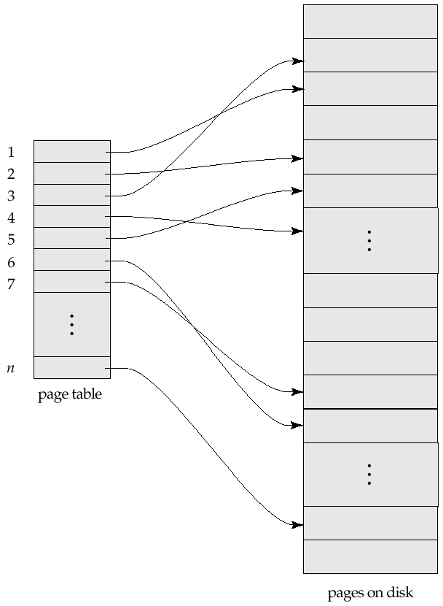
Sample Page Table

Slide 36
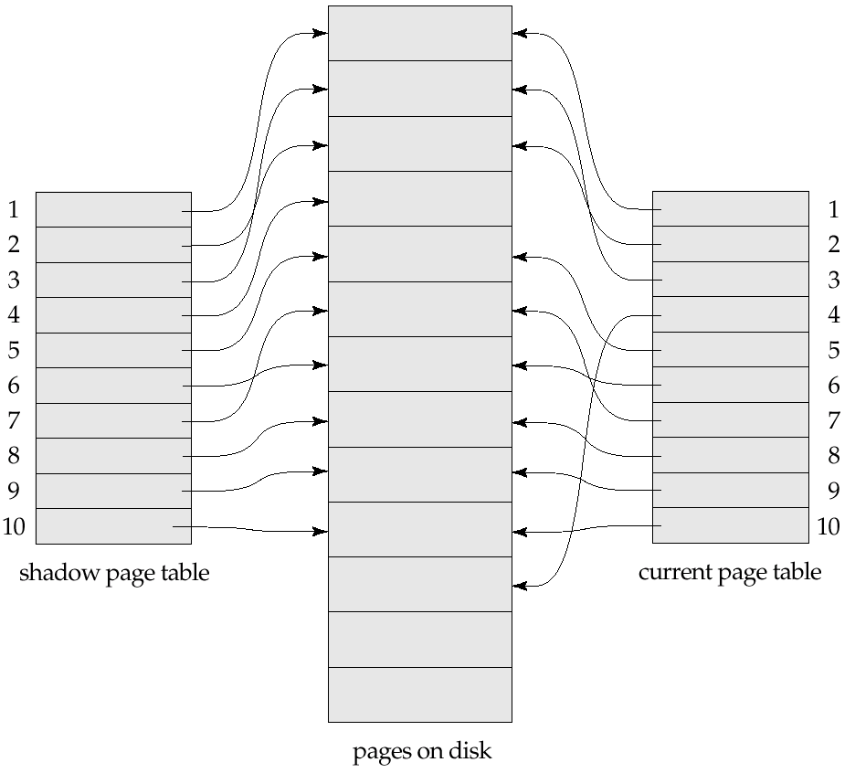
Example of Shadow Paging
Shadow and current page tables after write to page 4

Slide 37
Shadow Paging (Cont.)
To commit a transaction :
1. Flush all modified pages in main memory to disk
2. Output current page table to disk
3. Make the current page table the new shadow page table, as follows:
keep a pointer to the shadow page table at a fixed (known) location on disk.
to make the current page table the new shadow page table, simply update the pointer to point to current page table on disk
Once pointer to shadow page table has been written, transaction is committed.
No recovery is needed after a crash — new transactions can start right away, using the shadow page table.
Pages not pointed to from current/shadow page table should be freed (garbage collected).

Slide 38
Shadow Paging (Cont.)
Advantages of shadow-paging over log-based schemes
no overhead of writing log records
recovery is trivial
Disadvantages :
Copying the entire page table is very expensive
Can be reduced by using a page table structured like a B⁺-tree
No need to copy entire tree, only need to copy paths in the tree that lead to updated leaf nodes
Commit overhead is high even with above extension
Need to flush every updated page, and page table
Data gets fragmented (related pages get separated on disk)
After every transaction completion, the database pages containing old versions of modified data need to be garbage collected
Hard to extend algorithm to allow transactions to run concurrently
Easier to extend log based schemes

Slide 39

Thank You!!!

Slide 40
Recovery With Concurrent Transactions (Cont.)
Checkpoints are performed as before, except that the checkpoint log record is now of the form < checkpoint L>
where L is the list of transactions active at the time of the checkpoint
We assume no updates are in progress while the checkpoint is carried out
When the system recovers from a crash, it first does the following:
Initialize undo-list and redo-list to empty
Scan the log backwards from the end, stopping when the first <checkpoint L> record is found. For each record found during the backward scan:
if the record is <T_{i} commit>, add T_{i} to redo-list
if the record is <T_{i} start>, then if T_{i} is not in redo-list, add T_{i} to undo-list
For every T_{i} in L, if T_{i} is not in redo-list, add T_{i} to undo-list

Slide 41
Recovery With Concurrent Transactions (Cont.)
At this point undo-list consists of incomplete transactions which must be undone, and redo-list consists of finished transactions that must be redone.
Recovery now continues as follows:
Scan log backwards from most recent record, stopping when <T_{i} start> records have been encountered for every T_{i} in undo-list.
During the scan, perform undo for each log record that belongs to a transaction in undo-list.
Locate the most recent <checkpoint L> record.
Scan log forwards from the <checkpoint L> record till the end of the log.
During the scan, perform redo for each log record that belongs to a transaction on redo-list

Slide 42
Example of Recovery
Go over the steps of the recovery algorithm on the following log:
<T₀ start>
<T₀, A, 0, 10>
<T₀ commit>
<T₁ start> /* Scan at step 1 comes up to here */
<T₁, B, 0, 10>
<T₂ start>
<T₂, C, 0, 10>
<T₂, C, 10, 20>
<checkpoint {T₁, T₂}>
<T₃ start>
<T₃, A, 10, 20>
<T₃, D, 0, 10>
<T₃ commit>

